Slide 1
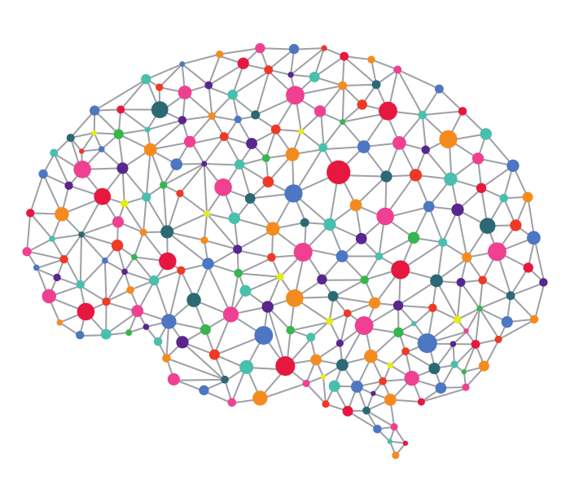
Intro to Neural Networks in Python Using Keras
Jared Stufft

Slide 2




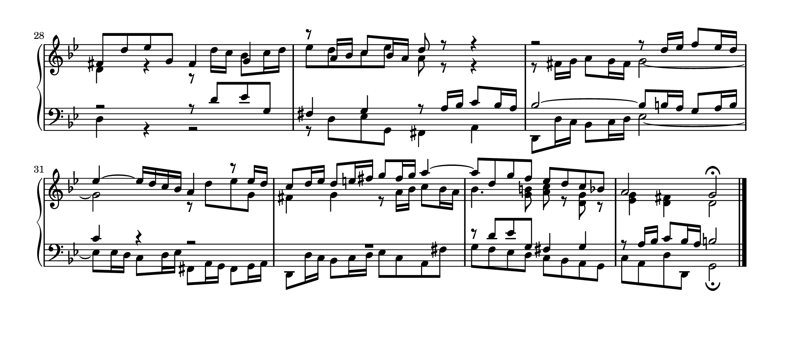


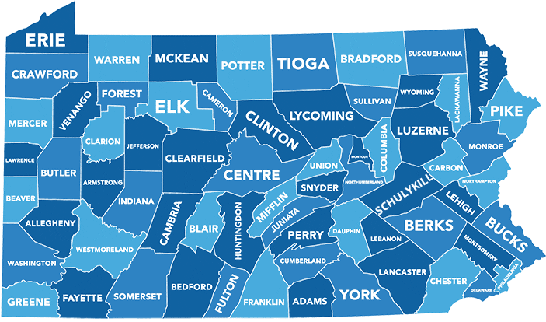

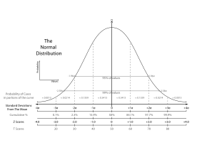


Who I Am
Notes:
Born and raised in Central Pennsylvania, moved to Boston in June 2018
Attended Penn State for music performance, specifically Voice
Studied statistics and received master’s degree in statistics from West Chester University outside Philadelphia, PA
Typical Tech stack includes Python, R, SAS, Tableau, and a variety of relational databases (SQL)
Currently I work at Wayfair in Copley as a business intelligence analyst supporting marketing strategy and decision making
Also do a fair bit of statistical consulting and freelance data science/data engineering for small/medium sized companies

Slide 3
What is a statistical or machine learning model?
A representation of reality using mathematics and logic
A way to describe relationships between different variables in a data set
A way to quantify those relationships to understand and/or predict
Can we profile our customers based on browsing behavior?
Does the weather/time of day/day of week affect MBTA ridership? By how much, on average? Can we use the data collected in the past to predict ridership at a given day/time?
Can we quantify the pixels of an image and use that to accurately identify an object?
How does Drug A affect recovery time compared to Drug B?
Notes:
I know that not everyone here is into data science, statistics, or machine learning
Let’s introduce at a high level what statistical or machine learning model is and why we do it

Slide 4
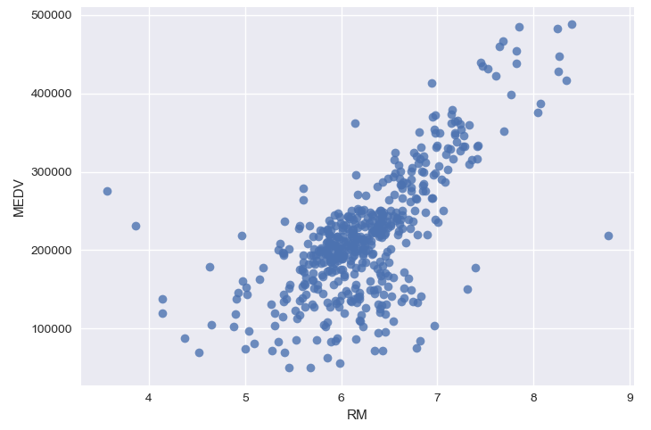
A Simple Model
Linear Model: Y’ = MX + B
Census Tract | Avg. # Rooms | Median Value
A | 6.575 | $240,000
B | 6.421 | $210,600
C | 7.185 | $340,700
... | ... | ...
Y | 6.442 | $220,900
Z | 6.211 | $250,000
Med. Value’ = Slope * Avg. Rms + Intercept
MEDV’ = 105,000 * RM - 400,000
MEDV’ = 105,000 * 6.5 - 400,000
MEDV’ = $282,500
Notes:
To give us an idea of what a simple predictive model looks like, let’s look at an example.
Let’s consider that’ve collected data on housing prices in boston.
For each census tract, we have the average number of rooms per house as well as the median home value of the census tract.
(You can tell the data are old because of how low the prices are – and I even had to multiply by 10 to make the numbers more believable)
If we plot these data on a scatter plot, we get something like this
Taking a closer look – we can see a pattern forming.
It looks like a straight line
This straight line forms the basis of a simple type of model called a linear model or linear regression
- Takes the form Y = MX + B (like we all learned in middle school)
If we apply to our housing data,
we have the Median Value as Y’
M, the Slope, or the average change in Median Value for a one room increase in average rooms and X, the average number of rooms
And the Intercept, which is our B from before
I eyeballed our line from the graph and determined our slope would be about 105,000 and our intercept would be about -400,000
If we were interested in predicted median home value for a census tract where the houses have 6.5 rooms on average, we can just plug 6.5 into our equation and evaluate
You can see the new point on the graph representing our prediction – it’s not too bad
Moving on – how do we go from this simple linear model to a neural network?
Really, what is a neural network?

Slide 5
What is a Neural Network?
“...a computing system made up of a number of simple, highly interconnected processing elements, which process information by their dynamic state response to external inputs.” - Dr. Robert Hecht-Nielsen
A complex matrix/network of weights (coefficients) which are optimized to most closely approximate a function describing the relationship between a set of inputs and an output.
Notes:
If you listen to Dr. Hecht-Nielsen (credited with creating the world’s first neurocomputer), he would say < read quote > … whoof.
A bit more simply, we can describe them as < read phrase >
You’ll see what I mean in a minute
For now, let’s talk about the make up of a simple neural network

Slide 6
Neural Network
Architecture

Slide 7
β₀
+
β₁
X₁
Y’
=
+
β₂
X₂
+
β₃
X₃
+...β_{n}X_{n}
Y’ = MX + B
(10 * .5) + (.5 * 8) + (4 * 20) + (1 + -8) = 41
10
.5
.5
8
41
20
4
-8
1
Notes:
Let’s consider our simple linear model from before; Y = MX + B
But let’s generalize it so we can use more than one input
This is actually the general form for the linear regression model
Here, Beta sub zero represents our intercept from before (our B)
Plus Beta sub one, X sub one, Beta sub two, X sub two… all the way through Beta Sub N X sub N, where X sub n represents the value of our Nth input variable and Beta sub n is the coefficient (or slope) for that variable.
If we take our X variables or inputs, we can rearrange them and assign them to a Node
We can then take our Y’ and assign it to its own node, and assign our betas to weights.
We also have a node for our intercept, but it will take the value 1
So to recap, each X variable gets a node, Y’ gets a node, we have an intercept node of 1, and the value of our betas and the intercept are represented by these connections/weights
I’m just going to make some numbers up and throw them in here for demonstrative purposes
Suppose we have three X variables, and for one of the rows in our data the value of X1 is 10, X2 is .5, and X3 is 4. Our coefficients for each of these variables are .5, 8, and 20 respectively, and our intercept is -8.
Just like before, we can multiple each value by the weights and sum them up to get our output
This forms the graphical representation of our linear model here

Slide 8
Hidden Layer
(10 * .5) + (.5 * 8) + (4 * 20) + (1 + -8) = 41
X₁
β₁
Output Layer
10
.5
β₂
Y’
X₂
.5
8
41
β₃
20
X₃
-8
4
β₀
1
Input Layer
1
Notes:
At this point, you’ve actually already learned 90% of the math that we need
We can add to our architecture to start forming our first neural network
Let’s take away our connections from before
And add another set of nodes between our inputs and our output
Just like before, we’ll make connections from the input nodes to this new set, until each node from the first layer is connected to each node in the second layer
We’ll then connect the nodes from the middle layer to our last layer and add another intercept node and connection
You can see that the connections between our middle layer and our last layer look exactly like the graphical representation of our linear model from before, just with an extra node
The math here is exactly the same as the linear model – multiple the value of a node by the each connection and sum up all of these products for the node it’s headed to
For some terminology: This first layer is very creatively called the input layer
This middle layer is called a hidden layer, and by the way, you can actually have multiple hidden layers with different numbers of nodes
Finally, we again have some creative naming here with our output layer
So our neural network right now is pretty cool and capable of modeling some pretty complex relationships, but it has a flaw
That flaw is that no matter how many inputs, layers, or nodes we have, it’s only capable of predicting things in a straight line
Considering that we want this to also approximate non-linear functions, we need to do something about this
To fix, we’ll introduce something called Activation Functions

Slide 9



Activation Functions
f(
)
N₁ =
β₀+ β₁X₁+ β₂X₂+ β₃X₃
Introducing non-linearity to the model.
X₁
f(x) = …
Y’
Sigmoid
X₂
Tan-h
X₃
ReLU
f(x) = $\frac{1}{1+e^{−x}}$
f(x) = $\frac{2}{1+e^{−2x}}−1$
f(x) = $max⁡(0, x)$
1
1
Notes:
Activation Functions, quite simply put, are a way to introduce non-linearity to our model so that it can approximate things that are also non-linear
Let’s look at our neural network that we built before
But let’s just focus on the connections between our input layer and a single node of our hidden layer
Mathematically, we can represent this portion of our network like this, where N1 is the value of our chosen hidden layer node
The idea of an activation function is that we can wrap this equation in another function to alter the value as it enters the node
In general, you choose on activation function per layer which applies to all values going to the next layer
There’s a lot of different choices (and research) about which activation functions to pick
Sigmoid
Tan-h, which is just a special case of the sigmoid
Rectified Linear Unit, or ReLU, which outputs zero if the argument is negative, otherwise just gives you back the value
Today, we’ll just use the ReLU as it can give good general results.
So we’ve talked about how the neural network relates to a linear model – where we take our inputs, multiple it through the network by a series of weights, pass through some activation functions, and finally end up with an output
But this assumes that we’ve already got our weights chosen and it’s the best representation of the function we’re trying to approximate, which of course we’ll never have right off the bat
In order to get the optimal values for our weights, we need to train our model.

Slide 10
Neural Network Training

Slide 11
Gradient Descent
Backwards Propagation
Y
-
Y’
=
E
Forward Propagation
52 | 19
7 | 2
30 | -6
-48 | 87
9 | -.01
33
1
5
.19
50
-.07
4
X₁
36
15
50
.19
4
-135
-80
.19
0
13
50
-2
-6
9.01
8
-2
Y’
X₂
7
20
-4
19
-.07
/ 5
SSE = 20716.18
50
-80
.19
-11
6
-11
MSE = 4143.24
X₃
.19
2
-.07
-2
.5
-6
22
Cost/Loss Function
.19
1
1
Notes:
Let’s again look at our neural network from before
Oh and just so you know, The process that we’ve been learning about, the passing of the inputs through the layers of the network is referred to as Forward Propogation
So we begin with our un-trained neural network, which is really just the skeleton of the architecture, and we intilialize the weights randomly
There’s literature on better ways to choose initial weights, but this is good enough for now.
Next, we’ll take a batch of our data, or a small sub sample, and forward propagate the inputs through our network using the random weights.
This gives us, for each observation in the batch, a first guess for Y (our Y’).
So let’s say that we ran a batch of 5 observations through the network with the random weights and got these guesses. You can see beside them are the observed values for our target, Y
By subtracting Y’ from Y, we can get a measure of Error, E, for each row
We then need to take this information and aggregate it to get a measure of how accurate the model was on the entire batch of data
In this particular case, we can find the sum of squared errors (SSE) and then divide by the number of rows in the batch to get the mean squared error
This metric, the mean squared error, can be referred to as the Cost function, or Loss function, and maps the current weights to average model performance
Important to note – we’re using MSE because we’re doing a regression task where we’re predicting a continuous output
If we were doing a classification task, we’d choose a more appropriate cost function that better represents the model performance in that context.
Back to training our model
We’ll take the value of the cost function, and pass it back through the layers of the network
Along the way, we’ll update the value of the weights in a way that will hopefully reduce the cost function for the next batch
This process is called backwards propagation
To know which direction each weight should be moved, we can use an algorithm called Gradient Descent
We assume that the cost function has some shape, hopefully convex (parabola with open top)
Each time we complete a propagation cycle, we calculate the gradient (or derivative, or slope) of the cost function at that point
The weights are then moved in steps proportional to the gradient of the cost function at its current value
Over time, we reach a local minimum of the cost function which will hopefully be the global minimum as well
At this point, our model will be optimized and ready for use to predict.

Slide 12
When Neural Networks are a Good Choice
You have a lot of data – hundreds of thousands if not millions (billions?) of rows for a structured data set.
Your data set does not conform to the traditional “structured” format
The relationships between the variables are extremely complex
You have a fair amount of computational resources available to you for training
You don’t require interpretability – you’re looking strictly for predictive power, no inference needed
Notes:
I think this presentation is not complete without briefly discussing when you might make the choice to use a Neural Network to create a predictive model versus something a little (or a lot) less complex
Neural Networks, while powerful, do take a lot of computational power to train efficiently and quickly
They also don’t give us as much easily interpretable information about the relationship between the variables as other model choices
(This is actually a criticism of self-driving cars which heavily employ NNs – we train the models to have a crazy amount of accuracy but don’t completely understand how it makes the predictions in terms of the relationships between the variables. This can be dangerous!)
In general, neural networks outperform other, more simple models under one or more (usually more) of the following conditions.
These conditions aren’t necessarily collectively exhaustive, by the way
First off – you have a ton of data! In order to get the staggering results you read about, it requires a lot of data for your neural network to see results above and beyond a simpler model
If your data is what we call “unstructured” – it doesn’t fit well into something like a relational database. The classic examples are text data and images.
The relationships between the variables are extremely complex – the effect of one variable on your outcome is itself dependent on the other variables (otherwise known as interaction) or the nature of the data, such as an image, has no clear interpretation anyways.
The computational power available to you is sufficient – you’ll see in the code example that even on a relatively small data set, it can take a while to train. Imagine have millions of rows with thousands of variables!
Neural Networks are often called black box models because we don’t have much insight into interpreting the relationships between the variables. You trade this off for higher accuracy potential.
That pretty much wraps up the mathematical portion of our light introduction to neural networks; now we can get to the fun part and learn how to build them with Python.

Slide 13
Frameworks/Libraries for Neural Networks
Data Cleaning
and Manipulation
Neural Network
Frameworks
Neural Network
Front-Ends
Pandas
Numpy
Tensorflow
Keras
Scikit-learn
PyTorch
CNTK
Theano
Lasagne
MXNet
Notes:
I have here listed some common libraries or frameworks used for neural networks in Python.
For Data Cleaning/Manipulation, we have Pandas which is kind of like an in-memory data store inside of Python which can hold our data before we send it through the model
Numpy can be used for speedy numerical calculations, but we’ll primarily use it for the array data structure
For frameworks, we have a few different approaches to conceptualizes applied neural network modeling
Tensorflow was built by google
PyTorch by Facebook
CNTK by Microsoft
Theano by university of montreal
These frameworks (particularly Tensorflow) can have pretty dense syntax – not user friendly
So we have some Front-End libraries like Keras, Scikit-Learn, Lasagne, and MXNet to make the coding part less of a hassle
Today we’ll focus on Pandas, Numpy, Tensorflow, and Keras

Slide 14
Code Example

